Slide 1
Frequency Distributions and Graphs Infographics Deck
15 infographic slides compiled into one presentation for study and training
1. Module 1: Organizing Data and Frequency Tables
• Organizing Data: From Raw Data to Frequency Distribution
• Anatomy of a Frequency Distribution Table
• Building a Grouped Frequency Distribution: Step-by-Step
• Categorical Frequency Distribution
• Frequency, Relative Frequency, and Percentage Frequency
2. Module 2: Frequency Graphs
• Histograms: Visualizing Numerical Frequency Distributions
• Histograms: Advantages, Limitations, and Bin-Width Effects
• Frequency Polygon: Connecting Class Midpoints
• Ogive: Understanding Cumulative Frequency
• Histogram vs Frequency Polygon vs Ogive
3. Module 3: Distribution Shapes
• Common Distribution Shapes
• Reading Distribution Shapes for Insight
4. Module 4: Other Graphs and Chart Selection
• Bar Graphs and Pie Graphs for Categorical Data
• Pareto Chart and Time Series Graph
• Choosing the Right Graph: A Beginner Decision Map
Cover Slide

Slide 2
Module 1: Organizing Data and Frequency Tables
5 infographic slides
Section 1 of 4

Slide 3
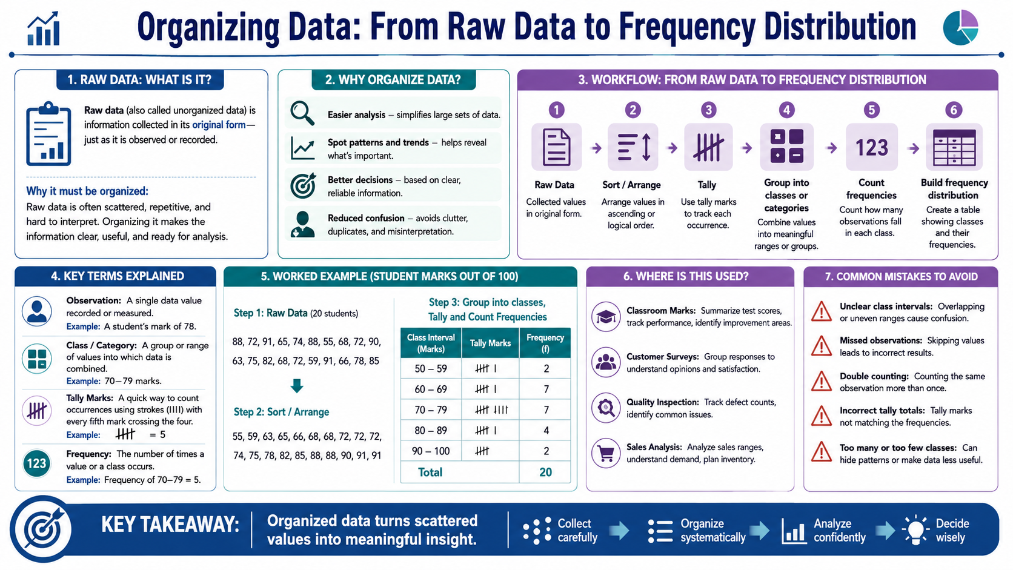
Organizing Data: From Raw Data to Frequency Distribution
Module 1: Organizing Data and Frequency Tables
Infographic 1 of 15

Slide 4
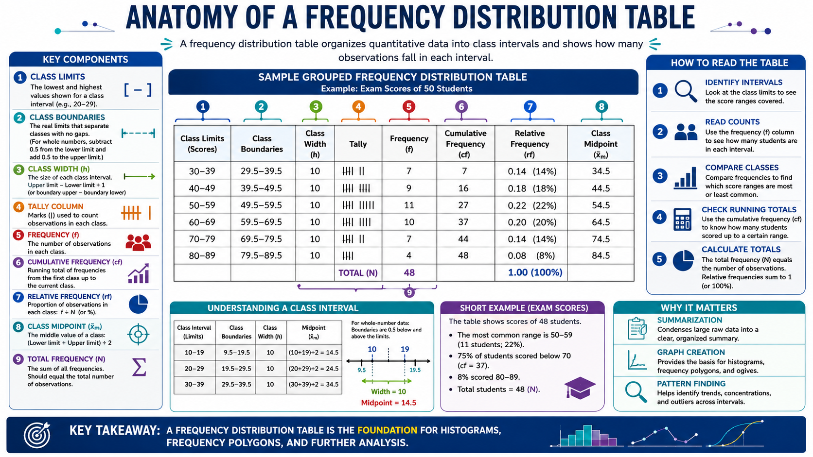
Anatomy of a Frequency Distribution Table
Module 1: Organizing Data and Frequency Tables
Infographic 2 of 15

Slide 5
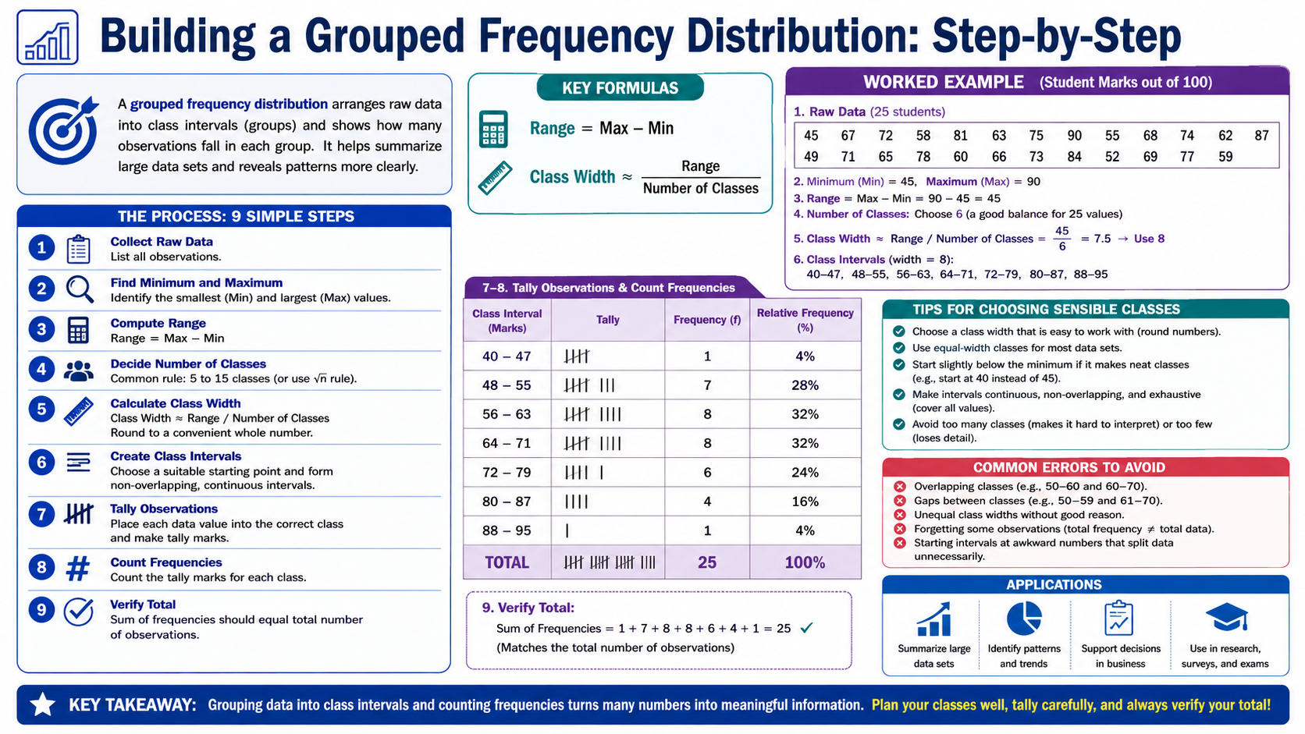
Building a Grouped Frequency Distribution: Step-by-Step
Module 1: Organizing Data and Frequency Tables
Infographic 3 of 15

Slide 6
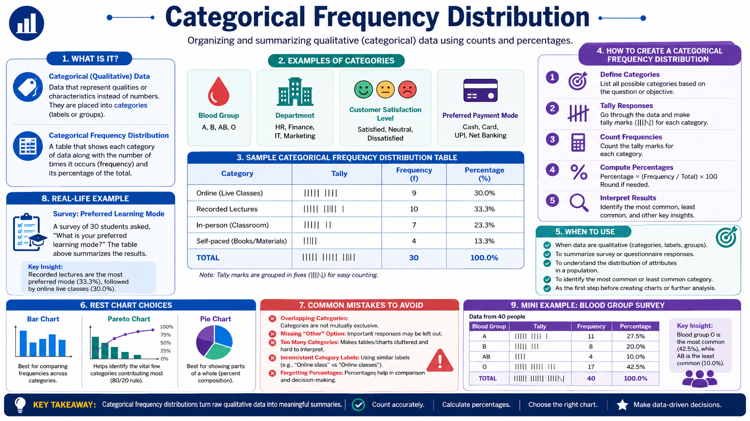
Categorical Frequency Distribution
Module 1: Organizing Data and Frequency Tables
Infographic 4 of 15

Slide 7
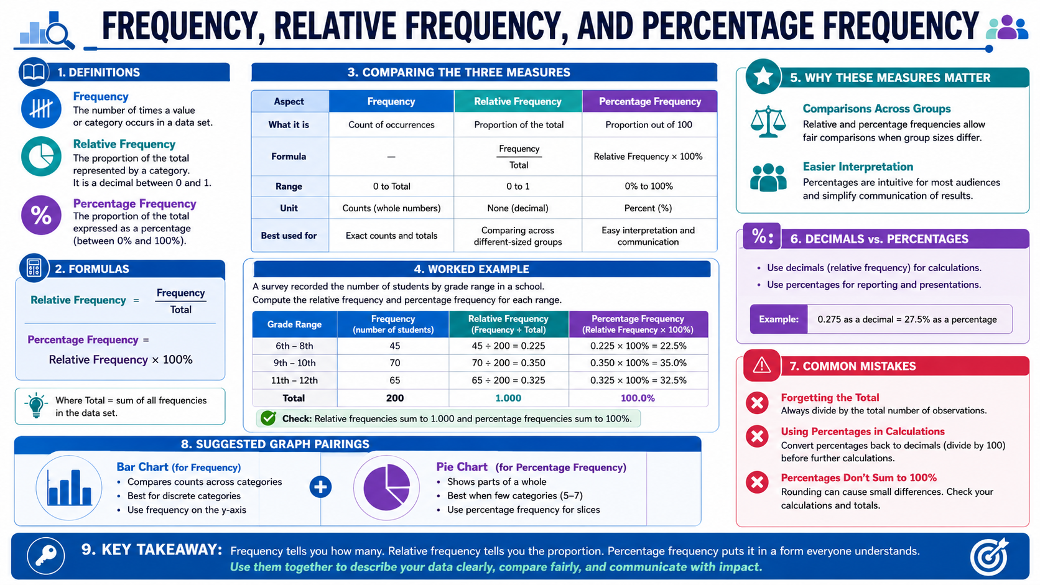
Frequency, Relative Frequency, and Percentage Frequency
Module 1: Organizing Data and Frequency Tables
Infographic 5 of 15

Slide 8
Module 2: Frequency Graphs
5 infographic slides
Section 2 of 4

Slide 9
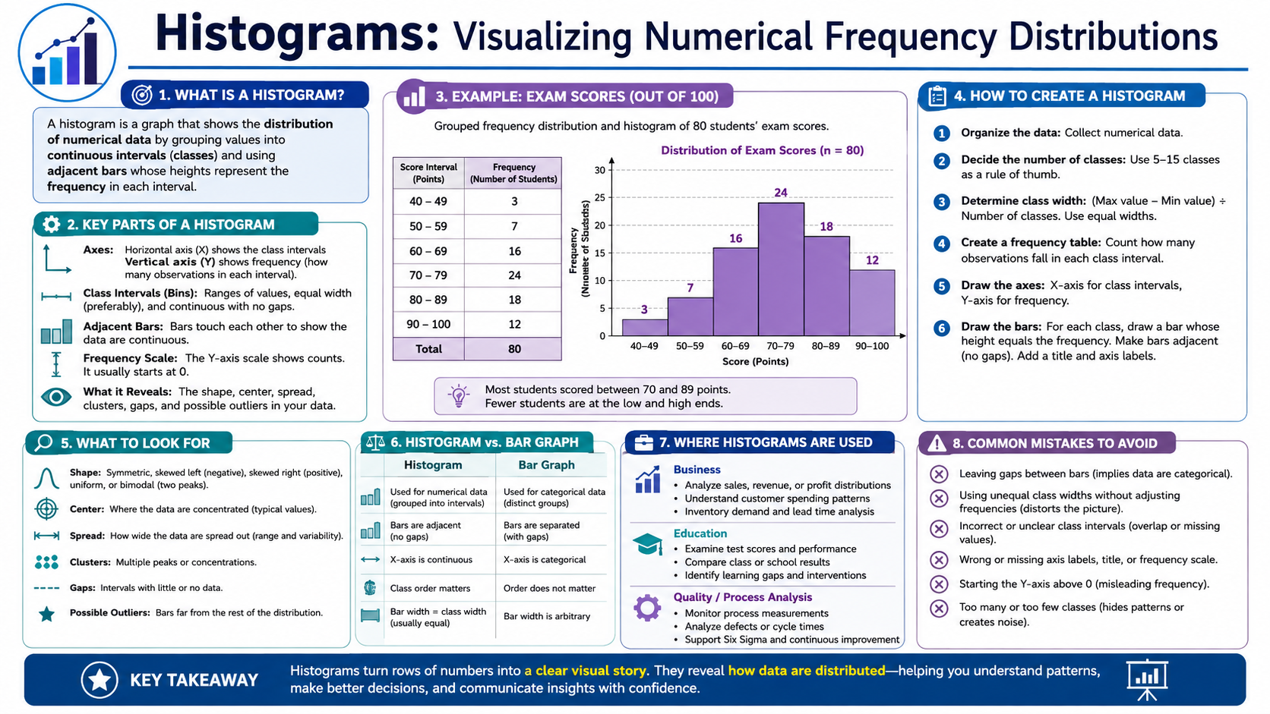
Histograms: Visualizing Numerical Frequency Distributions
Module 2: Frequency Graphs
Infographic 6 of 15

Slide 10
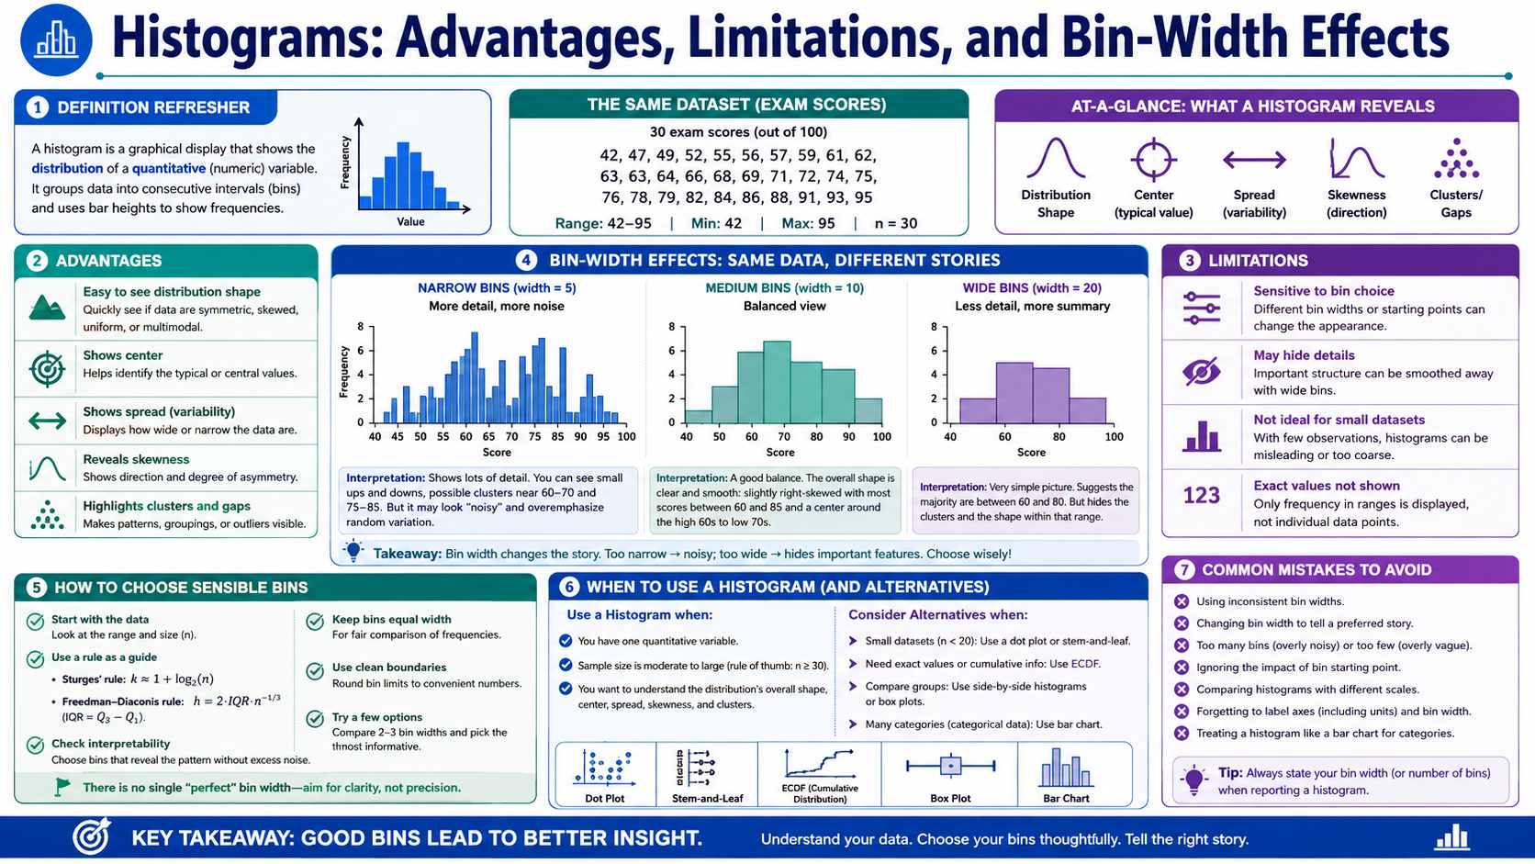
Histograms: Advantages, Limitations, and Bin-Width Effects
Module 2: Frequency Graphs
Infographic 7 of 15

Slide 11
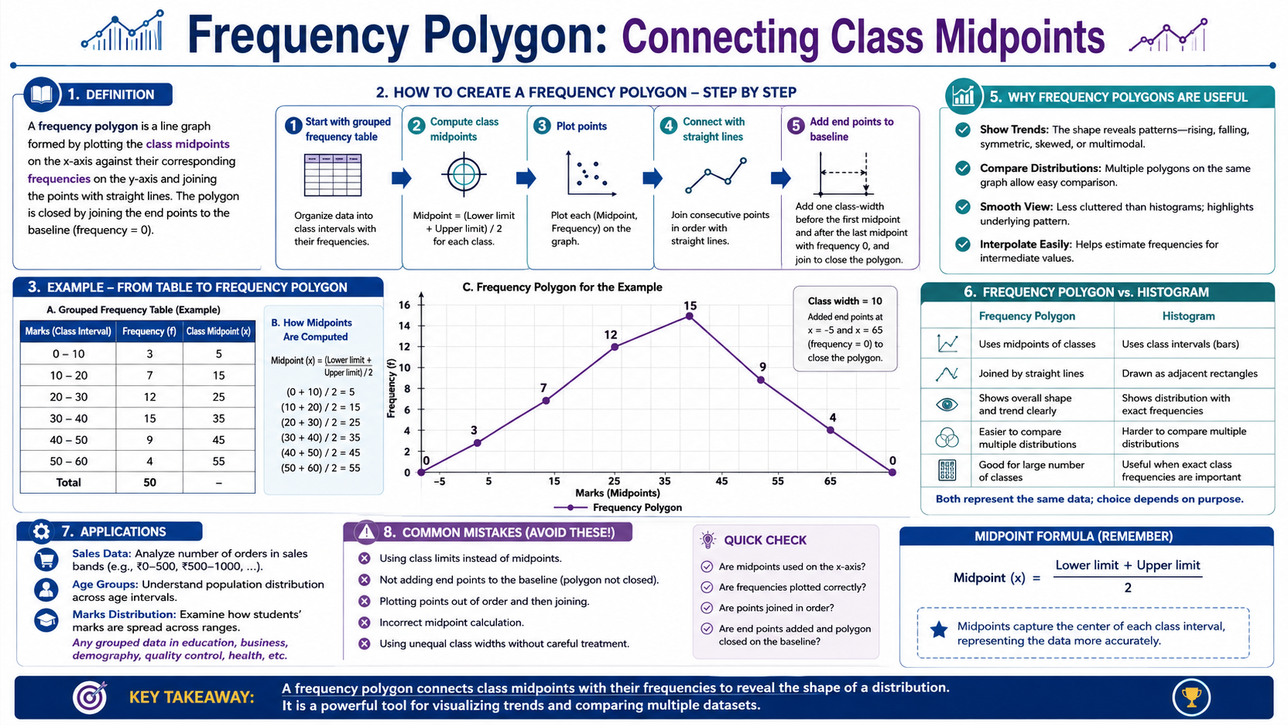
Frequency Polygon: Connecting Class Midpoints
Module 2: Frequency Graphs
Infographic 8 of 15

Slide 12
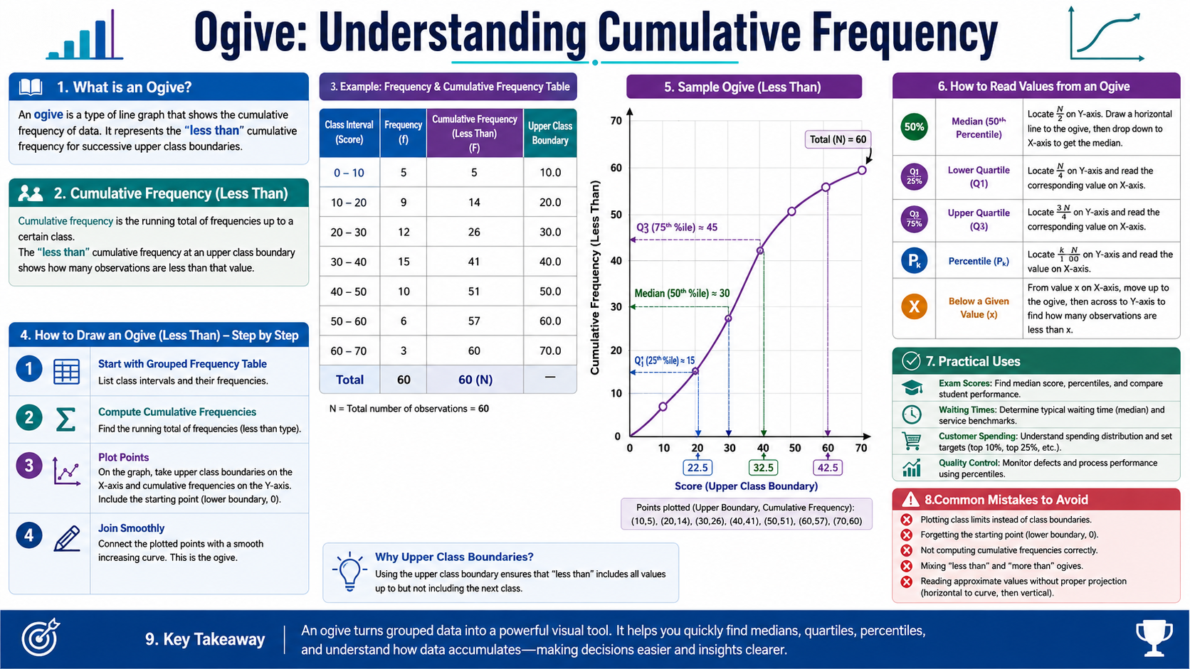
Ogive: Understanding Cumulative Frequency
Module 2: Frequency Graphs
Infographic 9 of 15

Slide 13
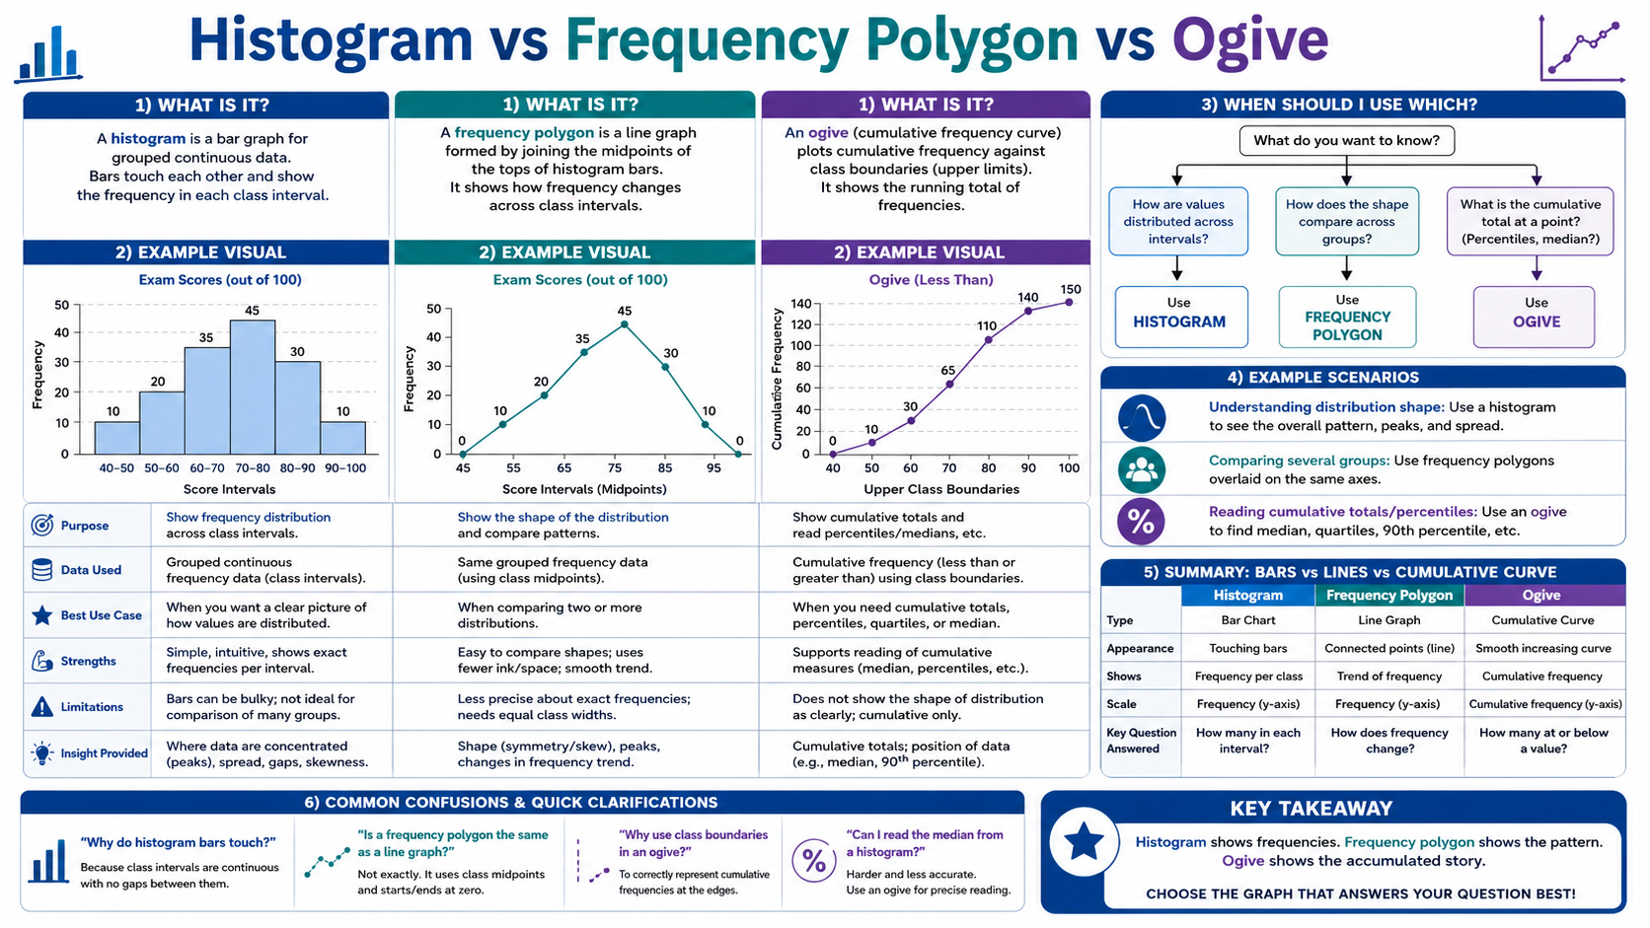
Histogram vs Frequency Polygon vs Ogive
Module 2: Frequency Graphs
Infographic 10 of 15

Slide 14
Module 3: Distribution Shapes
2 infographic slides
Section 3 of 4

Slide 15
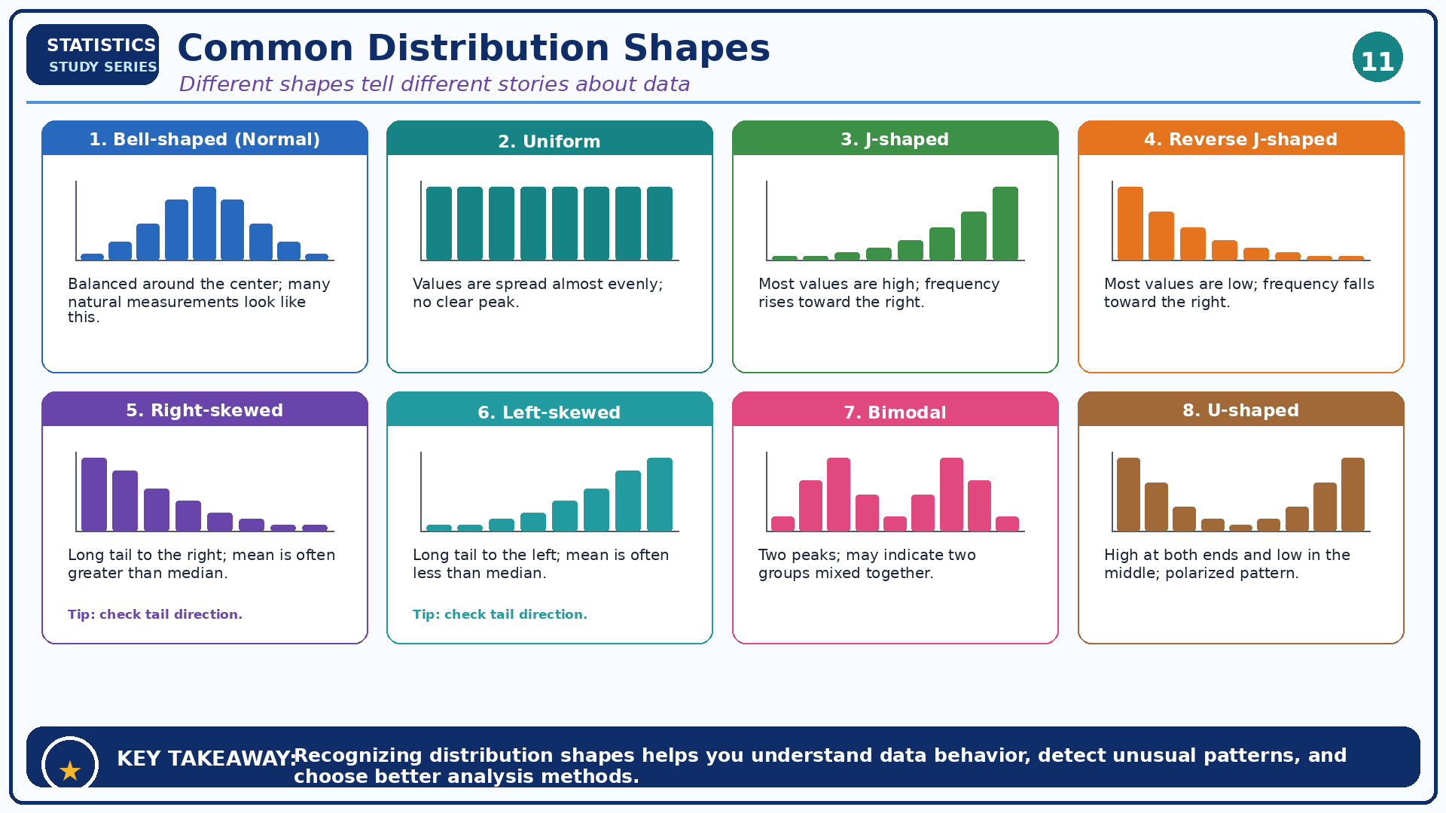
Common Distribution Shapes
Module 3: Distribution Shapes
Infographic 11 of 15

Slide 16
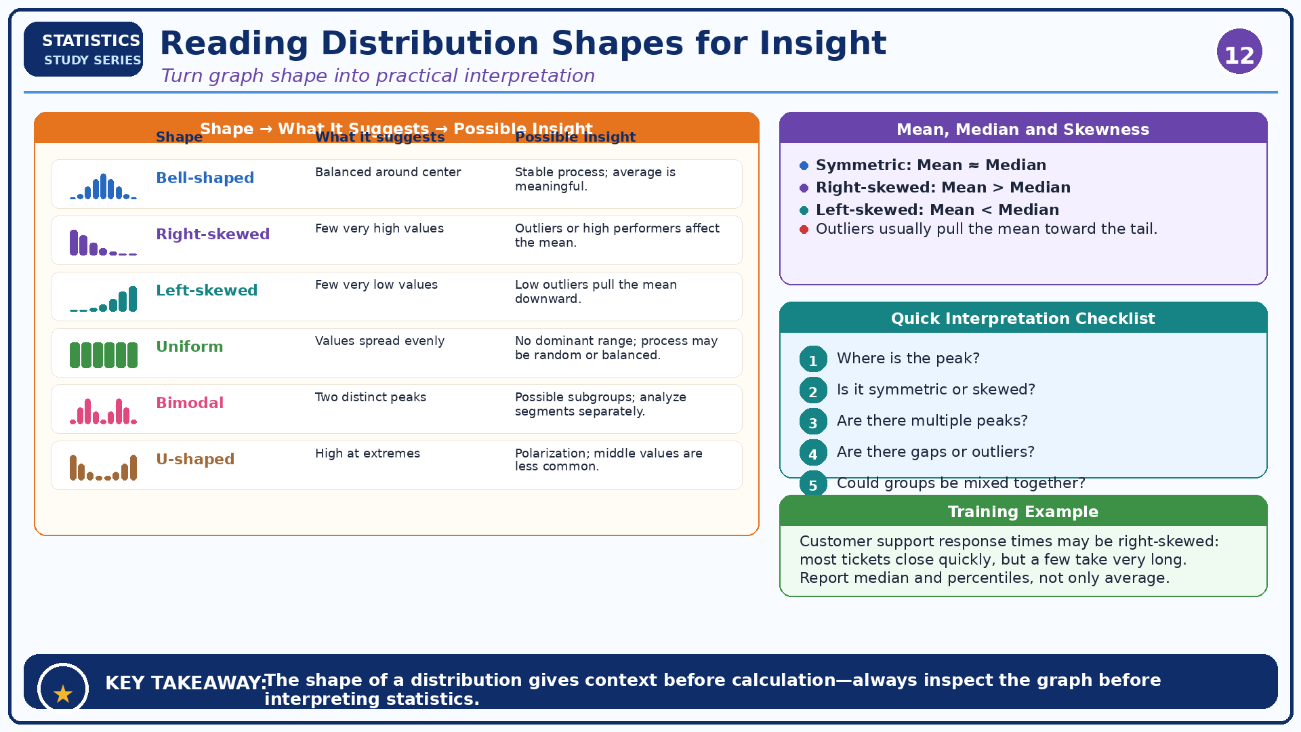
Reading Distribution Shapes for Insight
Module 3: Distribution Shapes
Infographic 12 of 15

Slide 17
Module 4: Other Graphs and Chart Selection
3 infographic slides
Section 4 of 4

Slide 18
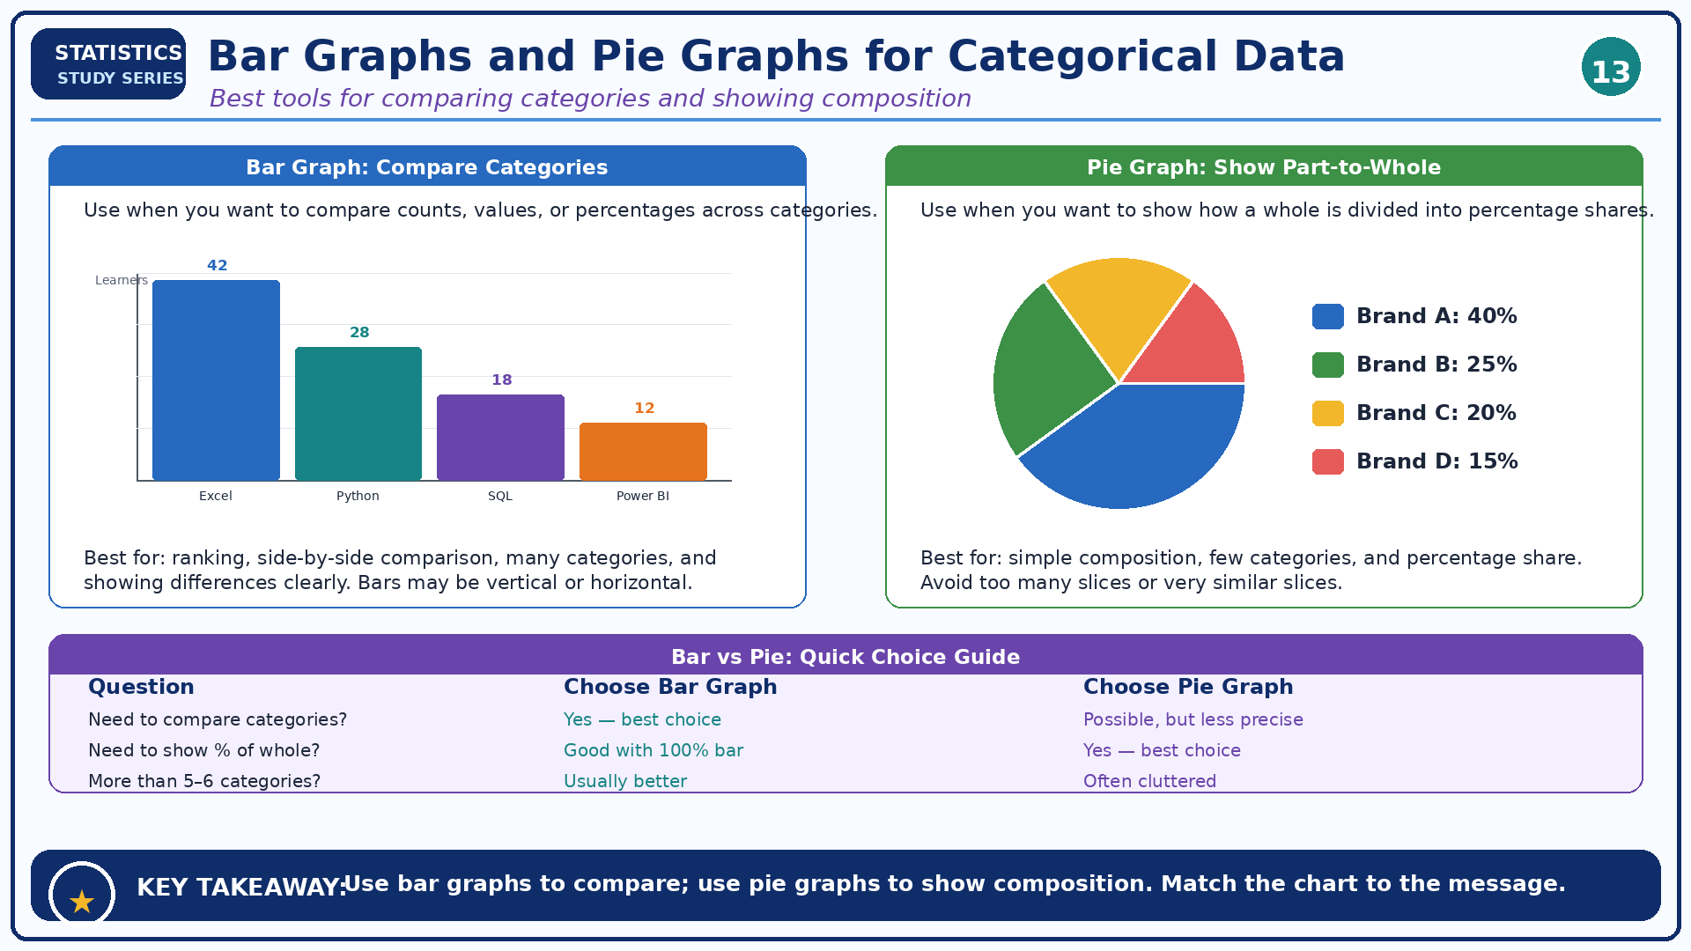
Bar Graphs and Pie Graphs for Categorical Data
Module 4: Other Graphs and Chart Selection
Infographic 13 of 15

Slide 19
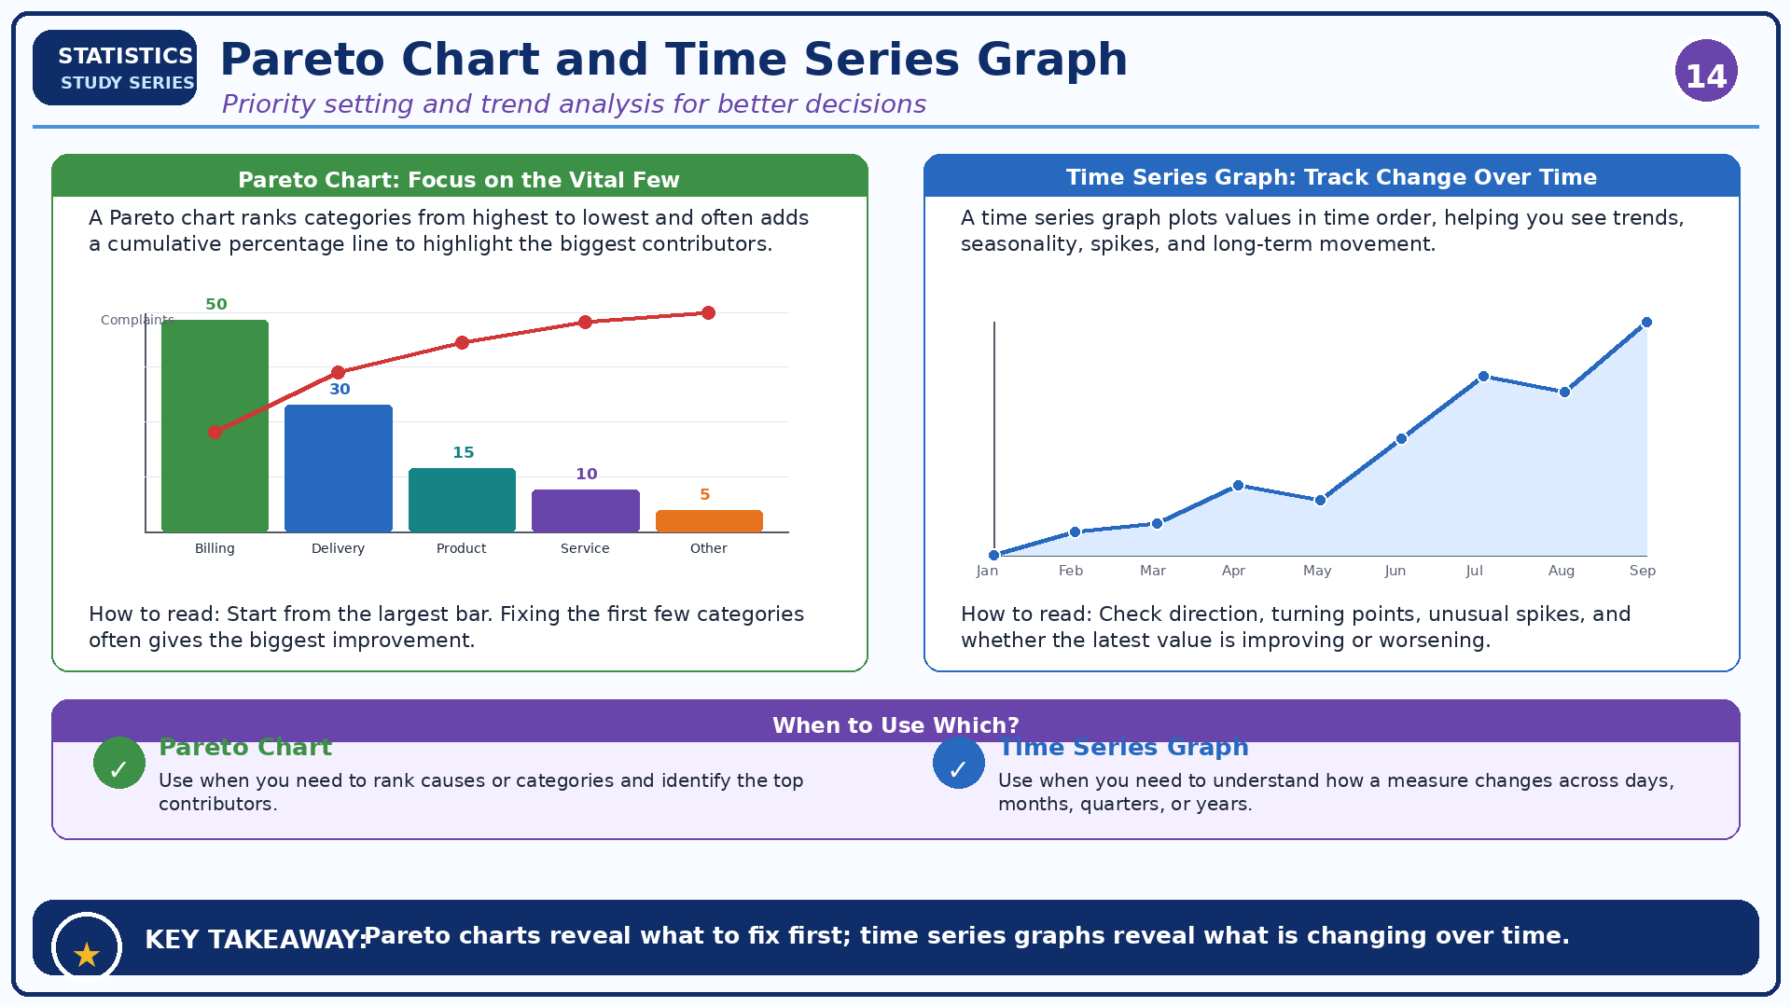
Pareto Chart and Time Series Graph
Module 4: Other Graphs and Chart Selection
Infographic 14 of 15

Slide 20
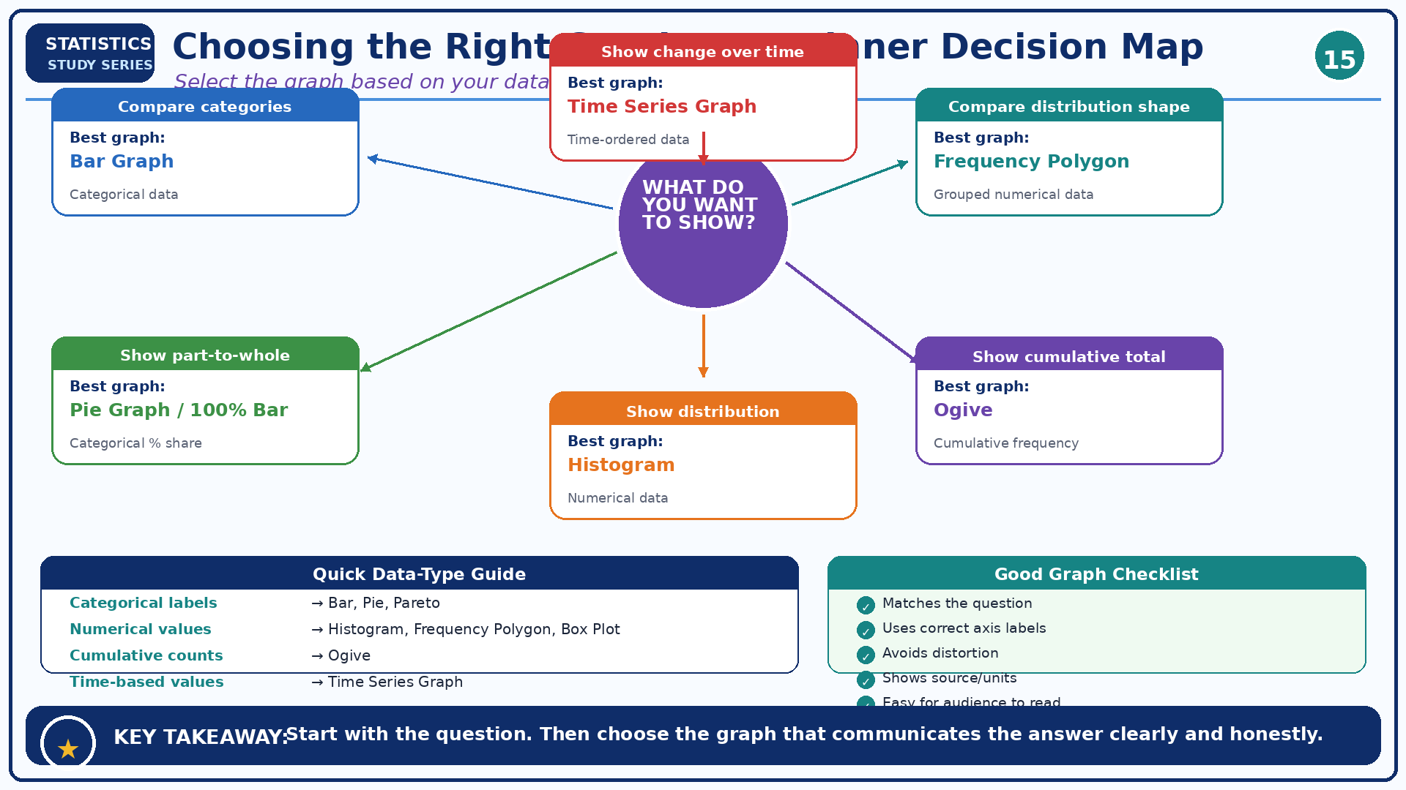
Choosing the Right Graph: A Beginner Decision Map
Module 4: Other Graphs and Chart Selection
Infographic 15 of 15

